Slide 1
network
201495004 kwon woo joo
201495005 Kim do young
201495014 Kim jae woo

Slide 2
iNDEX
Topology - RIP, EIGRP, OSPF, VLAN
Routing Table(RIP, EIGRP, OSPF)
Redistribution
Ping Test
QnA

Slide 3
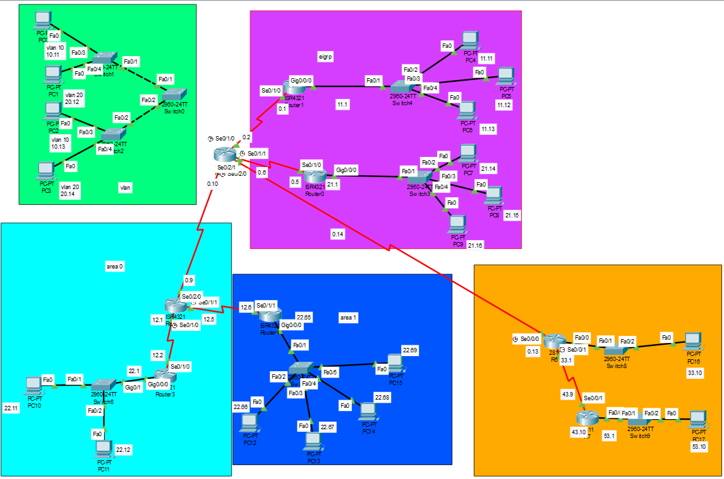
Topology - All

Slide 4
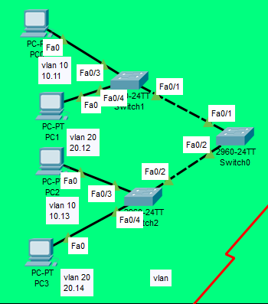
Topology-VLAN
Device | IP/Subnet | Gateway
PC0/VLAN10 | 192.168.10.11/24 | 192.168.10.1
PC1/VLAN20 | 192.168.20.12/24 | 192.168.20.1
PC2/VLAN10 | 192.168.10.13/24 | 192.168.10.1
PC3/VLAN20 | 192.168.20.14/24 | 192.168.20.1
VLAN 10 | 192.168.10.1/24 | N/A
VLAN 20 | 192.168.20.1/24 | N/A
Device | Interface | ip/sunbet
S0 | vlan99 | 192.168.99.11/24
S1 | vlan99 | 192.168.99.12/24
S2 | vlan99 | 192.168.99.13/24

Slide 5
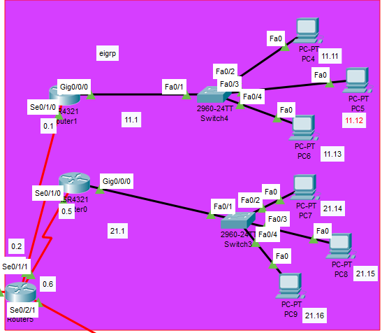
Topology-EIGRP
Device | interface | ip/subnet | Gateway
R0 | Se0/1/0 | 192.168.0.5/30 | N/A
 | Gi0/0/0 | 192.168.21.1/24 | N/A
R1 | Se0/1/0 | 192.168.0.1/30 | N/A
 | Gi/0/0/0 | 192.168.11.1/24 | N/A
R5 | Se0/1/1 | 192.168.0.6/30 | N/A
 | Gi0/1/0 | 192.168.0.2/30 | N/A
PC4 | NIC | 192.168.11.11/24 | 192.168.11.1
PC5 | NIC | 192.168.11.12/24
PC6 | NIC | 192.168.11.13/24
PC7 | NIC | 192.168.21.14/24 | 192.168.21.1
PC8 | NIC | 192.168.21.15/24
PC9 | NIC | 192.168.21.16/24

Slide 6
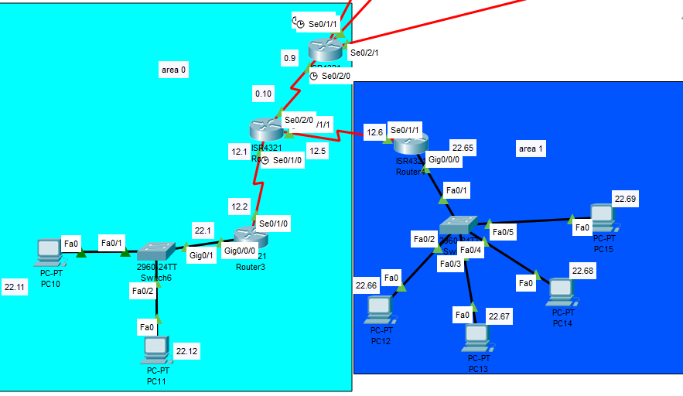
Topology-OSPF(Area0, Area1)
Device | Interface | Ip/Subnet | Gateway
R2 | Se0/1/0 | 192.168.12.1/30 | N/A
 | Se0/1/1 | 192.168.12.5/30 | N/A
 | Se0/2/0 | 192.168.0.9/30 | N/A
R3 | Se0/1/0 | 192.168.12.2/30 | N/A
 | Gi0/0/0 | 192.168.22.1/26 | N/A
R5 | Se0/2/1 | 192.168.0.14/30 | N/A
PC10 | NIC | 192.168.22.11/26 | 192.168.22.1
PC11 | NIC | 192.168.22.12/26
Device | Interface | Ip/Subnet | Gateway
R2 | Se0/1/1 | 192.168.12.5/30 | N/A
R4 | Se0/1/1 | 192.168.12.6/30 | N/A
 | Gi0/0/0 | 192.168.22.65/26 | N/A
PC12 | NIC | 192.168.22.66/26 | 192.168.22.65
PC13 | NIC | 192.168.22.67/26
PC14 | NIC | 192.168.22.68/26
PC15 | NIC | 192.168.22.69/26

Slide 7
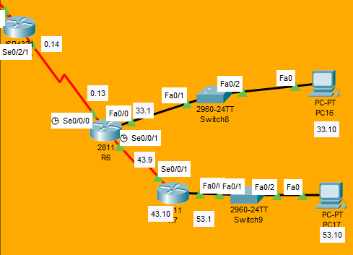
Topology-RIP
Device | Interface | Ip/Subnet | Gateway
R5 | Se0/2/0 | 192.168.0.10/30 | N/A
R6 | Se0/0/0 | 192.168.0.13/30 | N/A
 | Se0/0/1 | 192.168.43.9/30 | N/A
 | Fa0/0 | 192.168.33.1/30 | N/A
R7 | Se0/0/1 | 192.168.43.10/30 | N/A
 | Fa0/1 | 192.168.53.1/30 | N/A
PC16 | NIC | 192.168.33.1/30 | 192.168.33.10
PC17 | NIC | 192.168.53.1/30 | 192.168.53.10

Slide 8
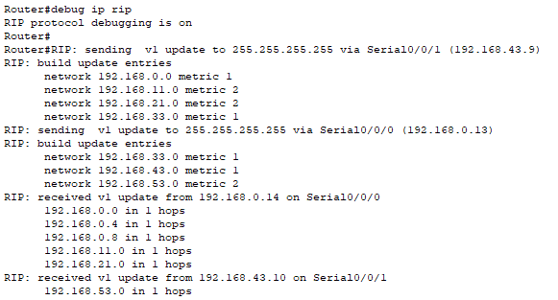
RIP 라우팅 테이블(hops)

Slide 9
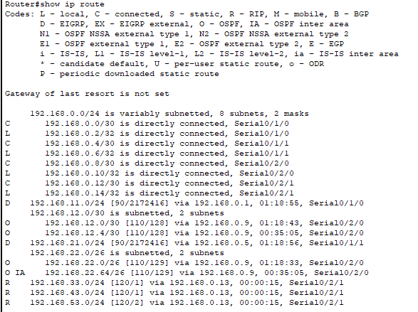
메인 라우팅테이블

Slide 10
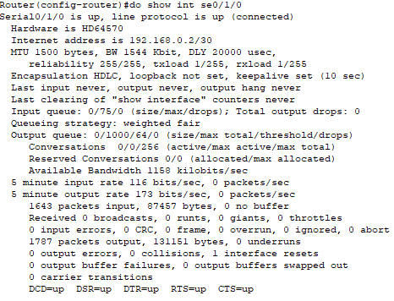
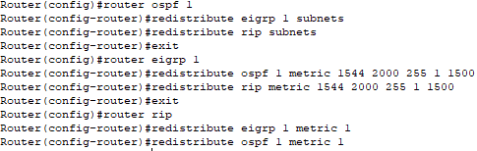
redistribution

Slide 11
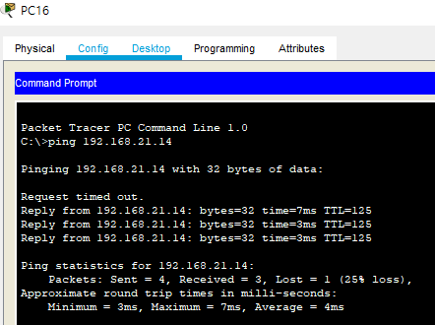
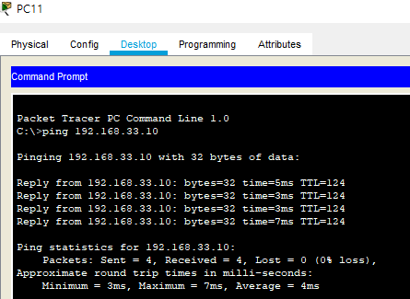
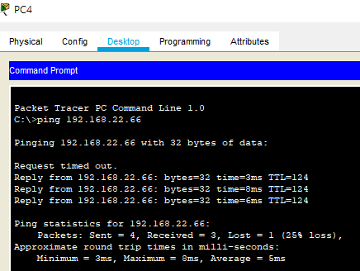
Ping Test
PC4 : Eigrp to Ospf
PC11 : Ospf to Rip
PC16 : Rip to Eigrp

Slide 12
QnA

